Slide 1
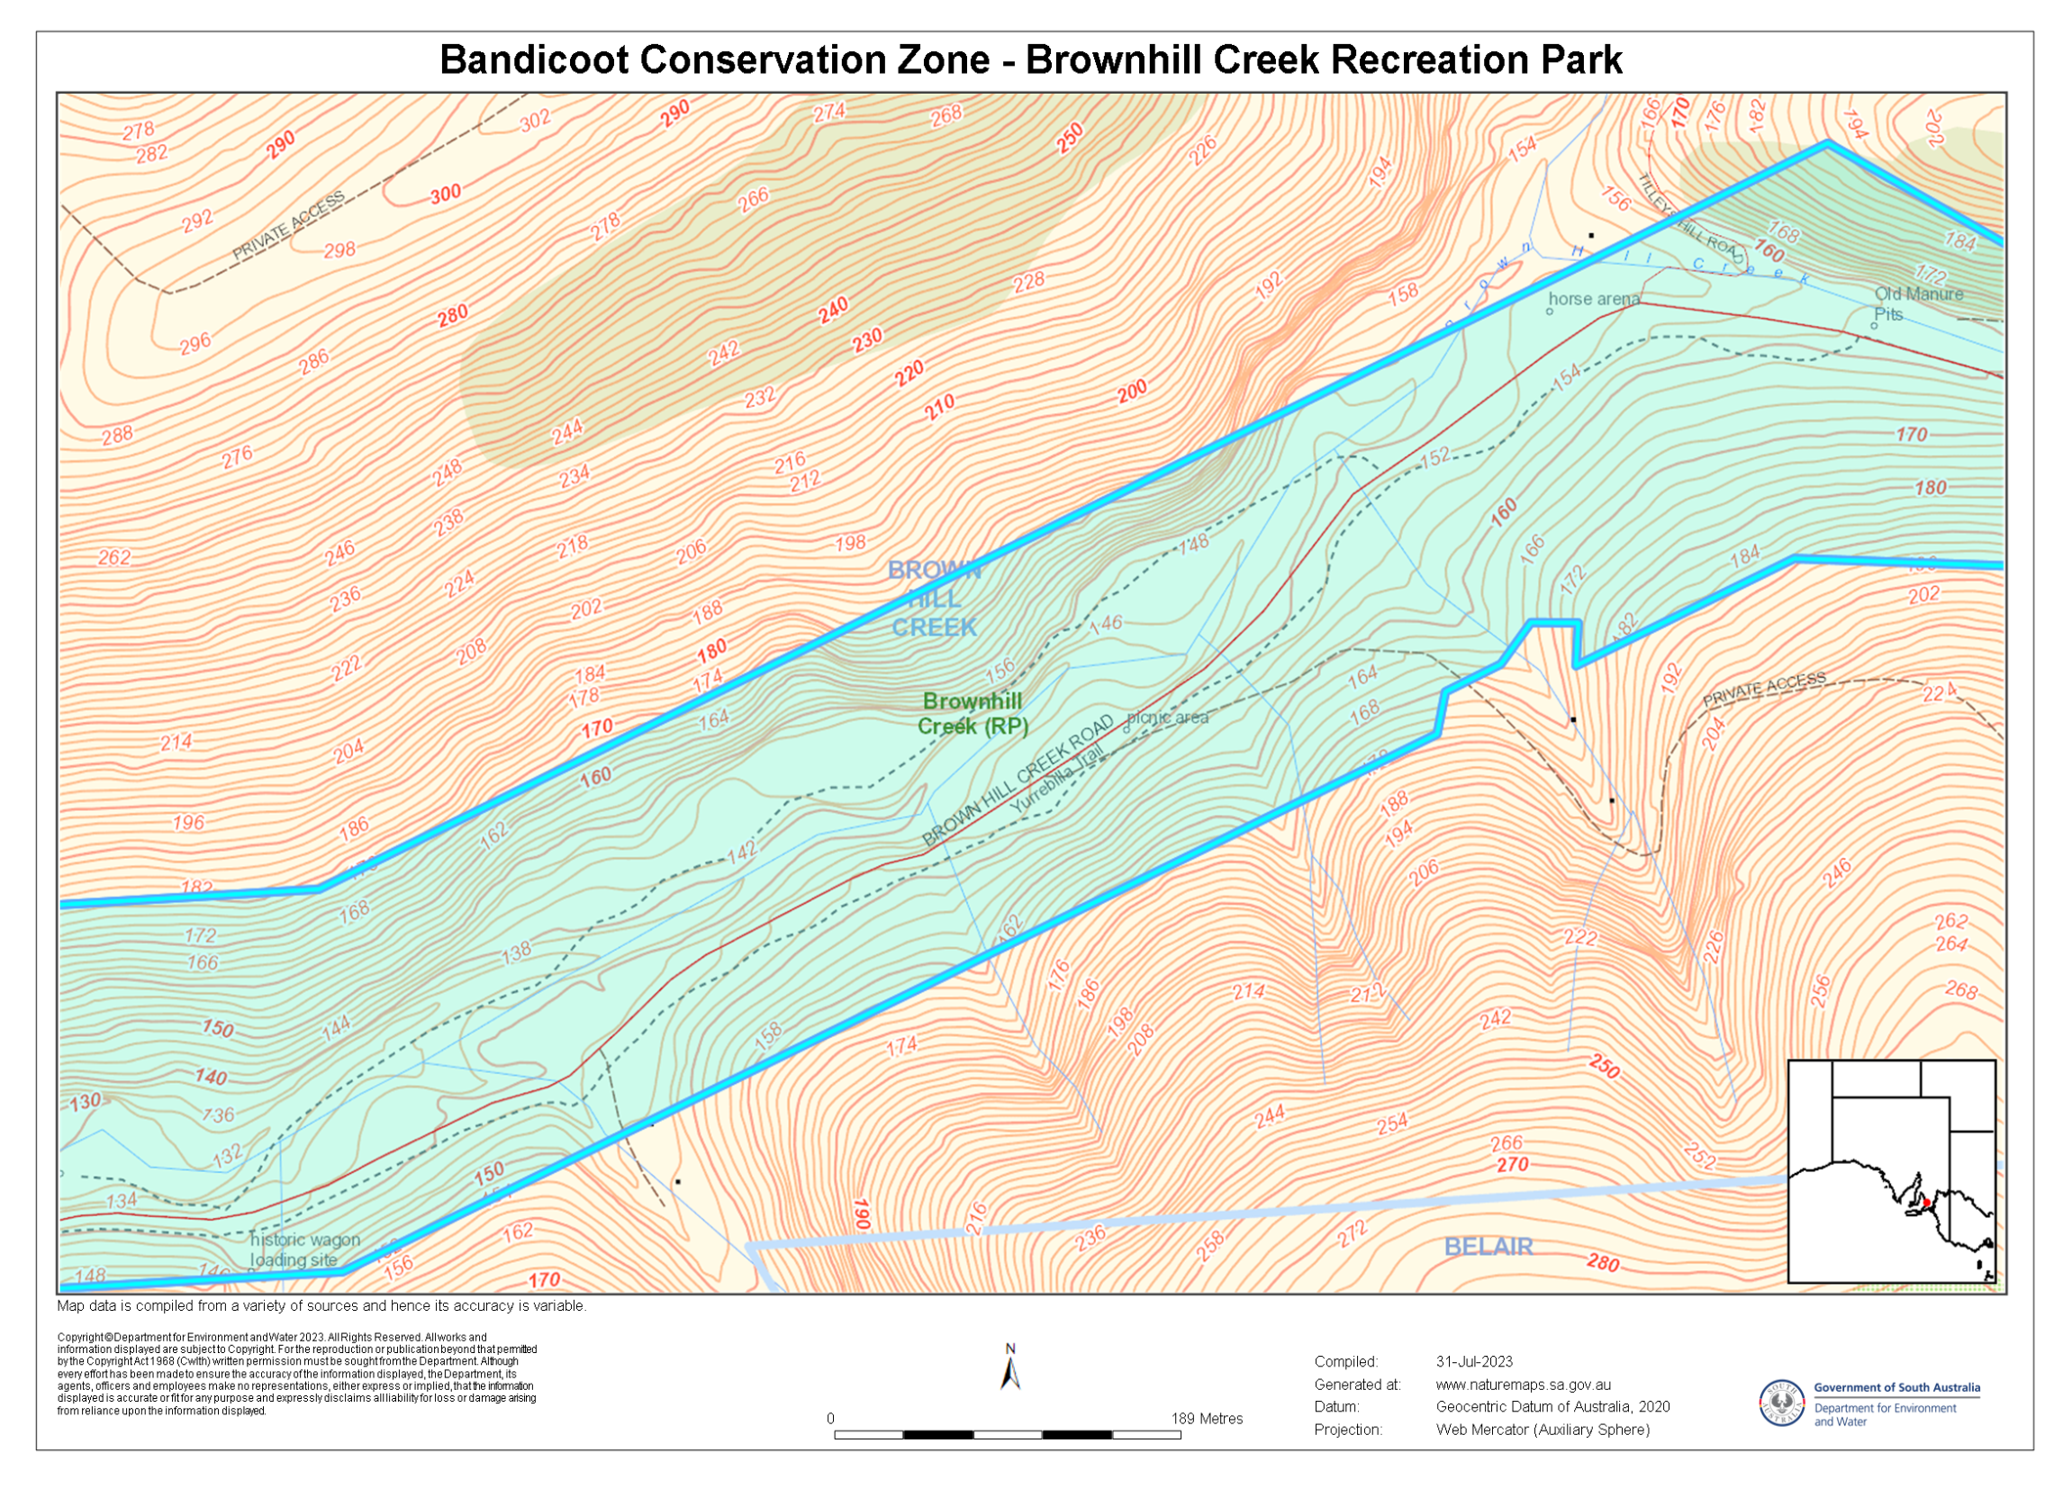
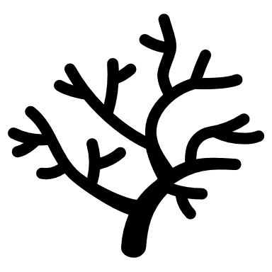
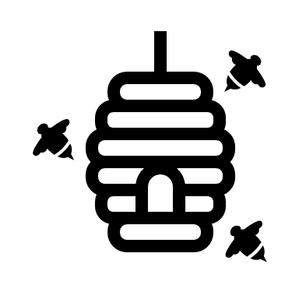
Legend
Zone Entry Sign
Native Habitat
P
Native Raspberry
Meadow
Shelter Tree
P
Fig Tree
Bandi Crossing
P
Bee Hub

Slide 2
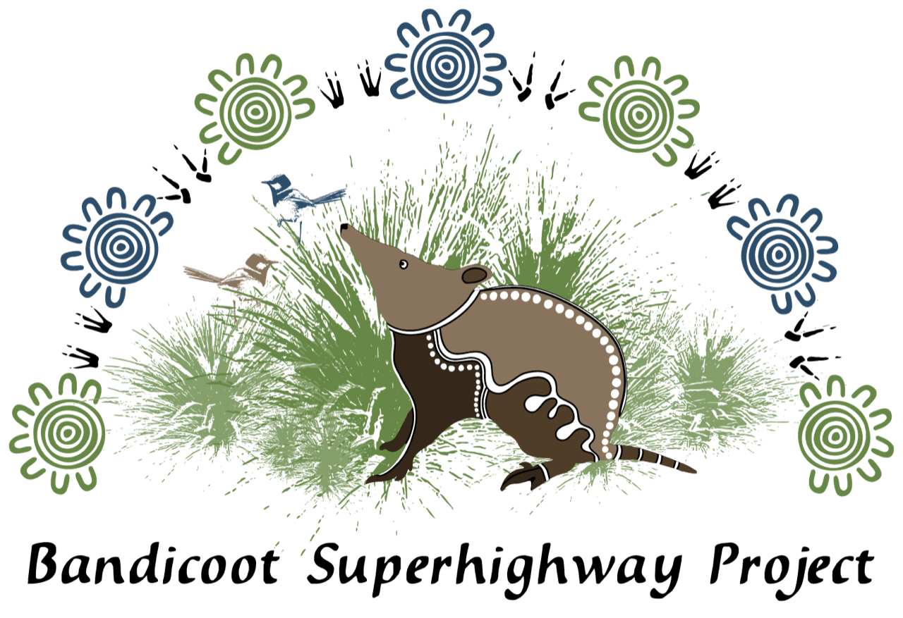
Native Habitat Patch
This area within Wirraparinga – Brownhill Creek Recreation Park’s red gum woodland is being restored by Friends of Brownhill Creek and University of Adelaide.
We help native plants to thrive by bushcare hand-weeding around them.
We help native fungi and invertebrates (bandicoot prey) to thrive by avoiding chemicals (no sprays).
This is the heart of our bandicoot habitat patchwork within Wirraparinga – Brownhill Creek Recreation Park’s Bandicoot Conservation Zone.
We’d love you to join us! Contact xxxx to find out how you can help the bandicoots.
Proudly funded by:
With support from Bandicoot Superhighway Partners:

Slide 3
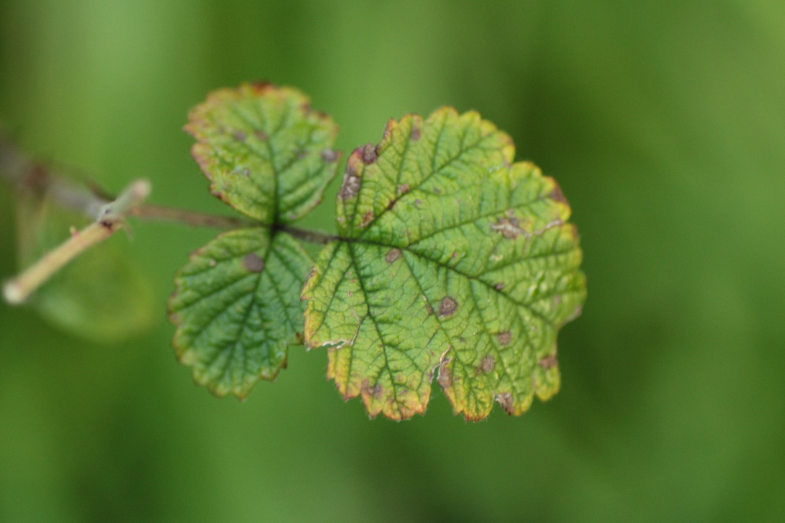
Native Raspberry Patch
Did you know this is Adelaide’s biggest native raspberry patch!?
Raspberry (Rubus parvifolius) is a native scrambler that is an important part of native bandicoot habitat in Wirraparinga–Brownhill Creek Recreation Park’s red gum woodland.
Raspberry is SA’s only native berry. How can you spot a native berry? The bush ALWAYS has leaflets with only 3 leaves (never 5).
This native raspberry patch is being restored by Friends of Brownhill Creek, Soursob Bob, and University of Adelaide. We help native raspberry to thrive by bushcare hand-weeding around them. Soursob Bob’s team of expert bushcarers are helping with cut & swab where needed.
We’d love you to join us! Contact xxxx to find out how you can help the bandicoots.
biggest leaflet ≤4 cm (check 15+)
Proudly funded by:
With support from Bandicoot Superhighway Partners:

Slide 4
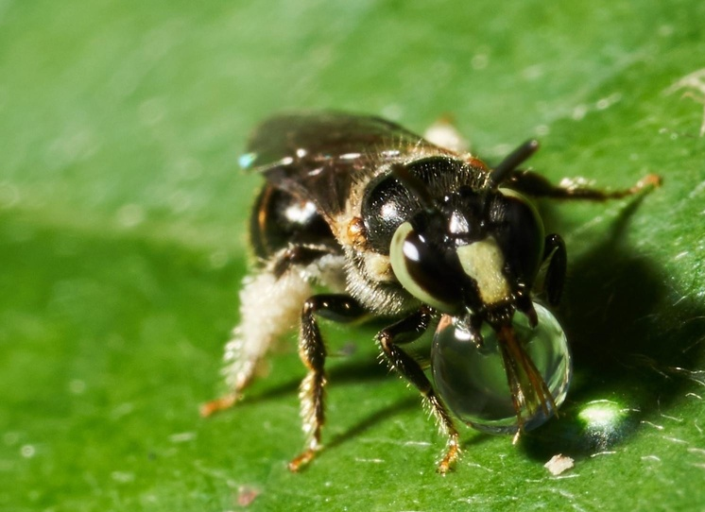
Native raspberry (Rubus parvifolius)
Native raspberry is essential habitat for bandicoots and bees.
Native reed bees (Exoneura, Braunsapis) can nest in dead twigs of raspberry. These tiny bees (to 8 mm long) are Australia's least known social bees!
Reed Bees have a glossy black head and thorax. Their black or orange-red abdomen is wedge-shaped (from side). Many have a cream T-shaped mark on their face.

